Slide 1
MODELLING AND FORECASTING OF NETFLIX STOCK PRICE

Slide 2
TIME SERIES ANALYSIS
Analysis of time series is of great importance not only to economist or businessman, but also to the people working in various disciplines in natural, social and physical sciences. The following points indicate the utility of time series analysis:
It enables us to study the past behavior of the phenomenon under consideration i.e., to determine the type and nature of variations in the data.
It helps in forecasting
It helps in evaluation of current achievement.
It helps in making comparative study.

Slide 3
Objectives of time series analysis
Description: To describe the data using summary statistics or graphical method.
Modelling: To find suitable mathematical model to describe the data generating process.
Forecasting: To estimate the future values of the series. Given an observed time series one may want to predict the future values of the series.
Control: Good forecast enable the analyst to take actions so as to control a given process, whether it is an industrial process or an economy or whatever.

Slide 4
About data
Secondary data which consists of daily opening stock price of Netflix
The data consist of 1009 observations starting from 5th February 2018 to 4th February 2022. The process of model fitting for daily opening of stock price was done using the statistical packages SPSS and R
Forecast of future open price of Netflix for next 30 days are made using ARIMA-GARCH Model.
Data is collected from THE SITE kaggle

Slide 5
TIME SERIES TOOLS
Use as it is
yes
Normality Test
We use actual level data
Variance is constant
Yes
Use ARIMA
No
Take a log
Check for stationarity
Variance ratio test
Use ARIMA with ARCH/GARCH
Variance is not constant
No
Take difference

Slide 6
Diagnostic Checking
Use ARIMA
Variance ratio test
Model fitting
Forecasting
Use ARIMA with ARCH/GARCH

Slide 7
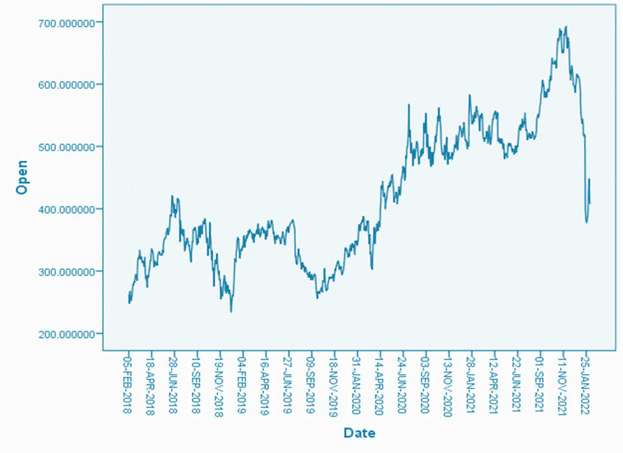
TIME SERIES PLOT
Here we can see that the price rises and falls through the time, and is very clear that data exhibit high level of volatility during the period of analysis. Only from the visual inspection of the data we cannot say if these changes in the mean are statistically significant. Accurate forecast is difficult unless the cause of fluctuations can be identified.

Slide 8
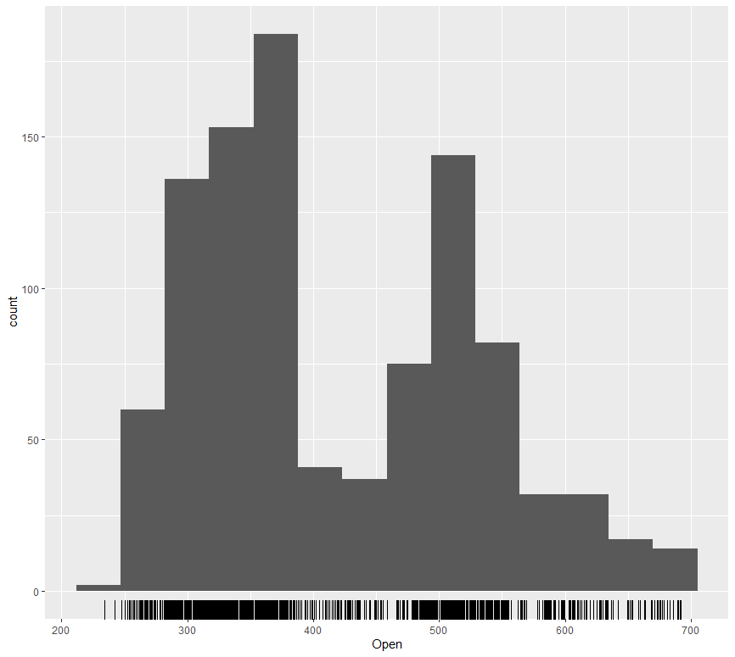
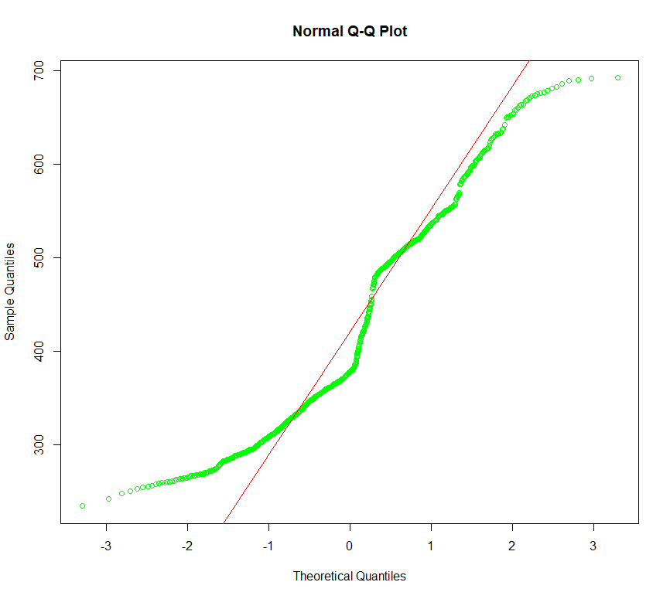
Normality
Frome Shapiro-Wilk and Kolmogorov-Smirnov Test P value is less than 0.05 hence we reject null hypothesis thus data is not normal.

Slide 9
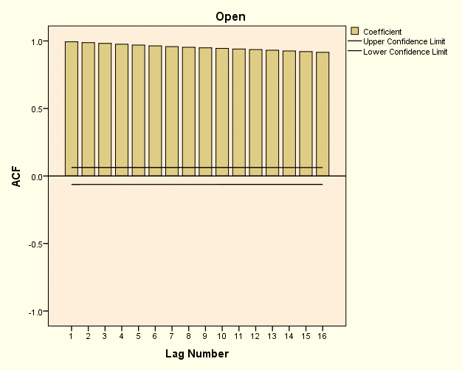
STATIONARITY
ACF fails to die out rapidly towards zero. Rather than dying down along the first several lags, the graph of ACF displays a slow decrease in the size of ACF values, which is a typical pattern for non-stationary series. From this it is clear that the original data is non-stationary.
From Augmented Dickey-Fuller (ADF) test, p-value is greater than 0.05 hence accepting null hypothesis(non stationary)

Slide 10
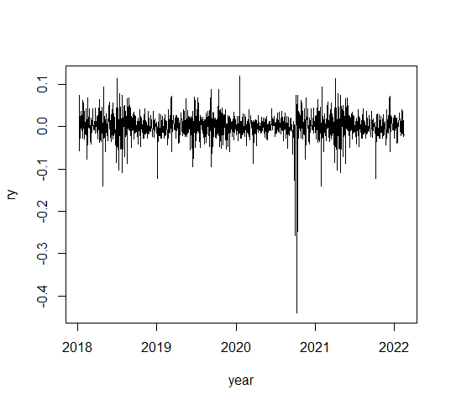
differenced time series data
After applying log and difference inorder to make our date normal and stationary respectively the output obtained is:
Data becomes stationary and hence our mean is constant

Slide 11
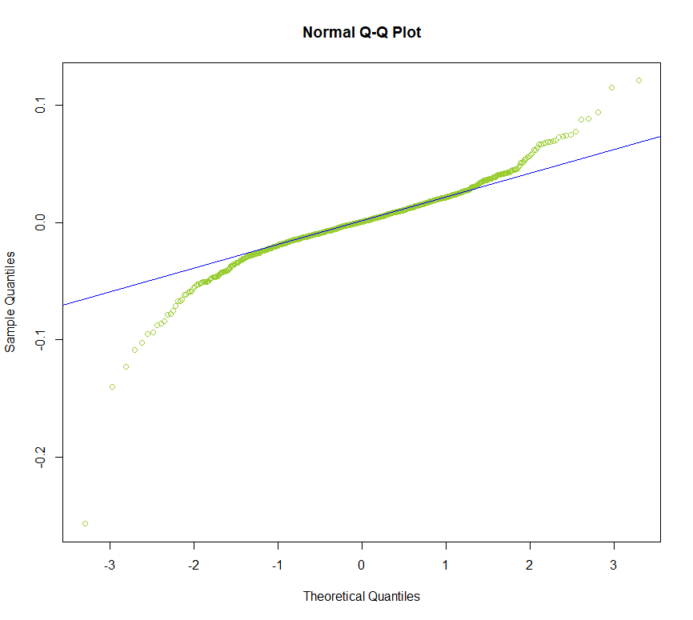
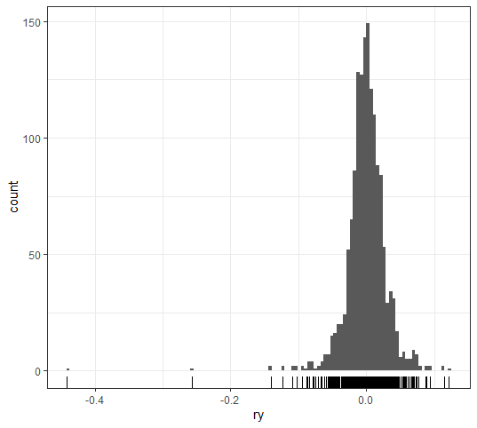
Normality and stationarity after differencing
From Dicky Fuller test after differencing p-value is less than zero hence rejecting null hypothesis(non-stationary)

Slide 12
MODEL FITTING
Using the r-code : auto.arima we obtain the best fitted model for our data :
ar1 ar2 ar3 ma1 ma2 ma3 intercept
0.7796 -0.48422 -0.3392 -0.8299 0.5292 0.3509 4e-04
AIC=-4408.78 AICc=-4408.67 BIC=-4374.37
Thus our arima model is arima (3,1,3)
Thus, the equation of the model becomes:
Y=0.0001+ (0.7796)y(t-1)+(-0.4822)y(t-2)+(-0.3392)y(t-3)+(-0.8299)et-1+ (0.5292)et-2+(0.3509)et-3

Slide 13
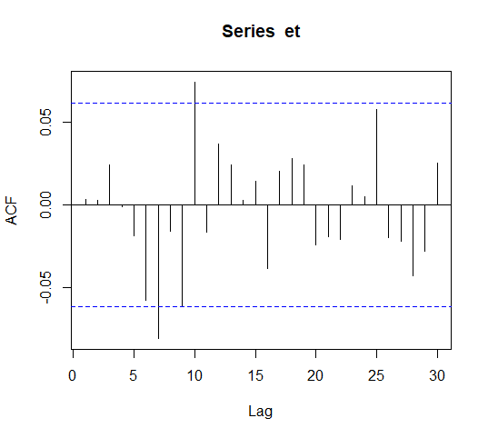
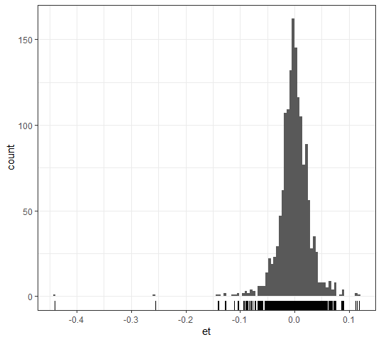
Diagnostic Checking

Slide 14
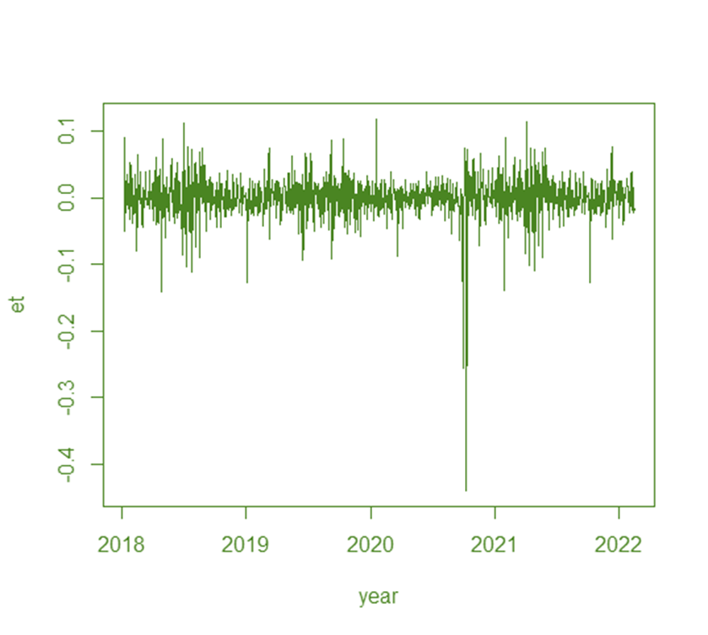
From the ACF graph it is clear that the first few points do not cross the control limits line. Until then it is independent and hence no autocorrelation is present in between the residuals. If we put a straight line through zero in the residual plot, we can see that their mean is zero. i.e., there is a constant mean in residuals at zero. But still there is some volatility present which ARIMA model could not cover up. From the normality graph it is clear that it is well shaped and it is normally distributed.
From the output we can conclude that the residuals are not correlated, it has a zero mean and it is normally distributed. From Box-Pierce, Ljung-Box test p value is greater than 0.05 hence we accept the null hypothesis and thus the residuals are independent and is not correlated.

Slide 15
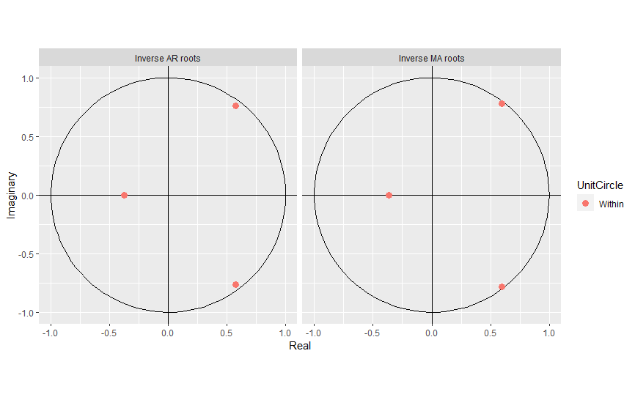
Since there is 3 MA and 3 AR there are 3 roots and since the dots are within the circle it shows that the model is stable Thus, the assumption random shocks have mean zero and non-constant variance.

Slide 16
ARCH-GARCH MODEL FOR VOLATILITY
IN THE RETURN GRAPH WE CAN SEE THAT, There is volatility clustering, that is small changes are followed by small changes and large changes are followed by large changes.
Since there is volatility present in our data, that is variance is not constant, we need to check the presence of arch effect in our model USING r, the p-value is less than 0.05, thus our null hypothesis is rejected hence there is arch effect.
THUS the garch model analysed using r is,
a0 a1 b1
0.0006464 0.0500001 0.0500000 Hence, there will be the GARCH order of (1,1). That is alpha1 represents the ARCH (p) order and beta1 represents the GARCH (q) order.

Slide 17
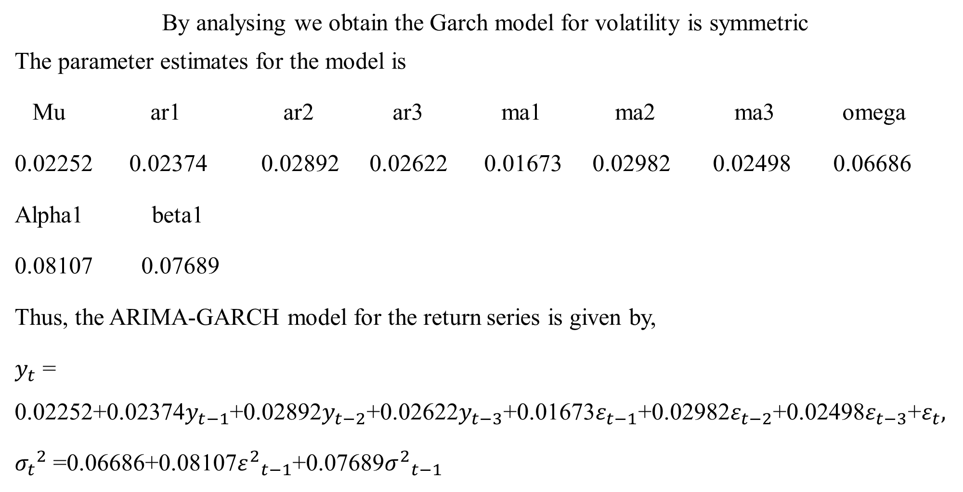
By analysing we obtain the Garch model for volatility is symmetric
The parameter estimates for the model is
Mu ar1 ar2 ar3 ma1 ma2 ma3 omega
0.02252 0.02374 0.02892 0.02622 0.01673 0.02982 0.02498 0.06686
Alpha1 beta1
0.08107 0.07689
Thus, the ARIMA-GARCH model for the return series is given by,
$y_{t}$ = 0.02252+0.02374$y_{t−1}$+0.02892$y_{t−2}$+0.02622$y_{t−3}$+0.01673$ε_{t−1}$+0.02982$ε_{t−2}$+0.02498$ε_{t−3}$+$ε_{t},$
${σ_{t}}^{2}$ =0.06686+0.08107${ε^{2}}_{t−1}$+0.07689${σ^{2}}_{t−1}$

Slide 18
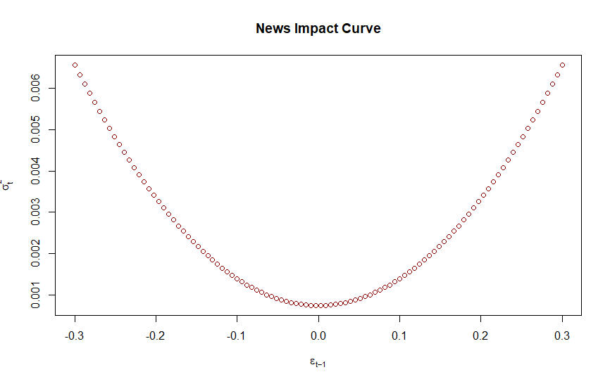
SYMMETRIC GRAPH
SINCE IT IS SYMMETRIC THERE IS EQUAL CHANCE OF HAVING NEGATIVE AND POSITIVE IMPACT.

Slide 19
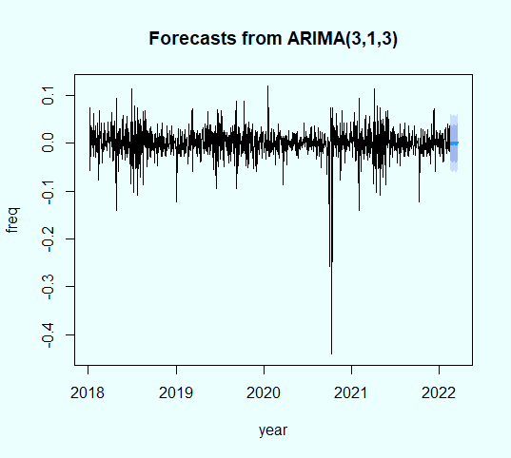
FORECASTING
THE MODEL ARIMA(3,1,3)-GARCH(1,1) IS STATISTICALLY ADEQUATE AND HENCE WE USE THIS MODEL TO FORECAST THE NEXT 30 OPEN PRICE OF NETFLIX USING THE GIVEN DATA AND THEN CHECK ITS ACCURACY.THE GRAPH OF THE FORECASTED MODEL IS :

Slide 20
ACCURACY
ME RMSE MAE MPE MAPE MASE ACFI
Training set 2.358982e-07 0.02696754 0.01876153 Inf Inf 0.6906292 0.000874935
Here mainly we check the accuracy of the forecasted values using MAPE. Our MAPE value tends to infinity i.e., maybe our observed value is zero so when divided it becomes infinite. So, next we check our MAE value which is equal to 0.01876153 which is significant hence our model is accurate.

Slide 21
CONCLUSION
This project takes up modelling and forecasting of the daily opening stock price of Netflix using ARIMA-GARCH time series model. Our empirical results suggest that ARIMA (3,1,3) models fit the return of stock price series well and GARCH (1,1) model fit the volatility of ARIMA (3,1,3) residuals. Thus, ARIMA (3,1,3)-GARCH (1,1) model is considered as the best model for the daily opening stock price of Netflix and they are capable of predicting the future trend of the price movement.
I CONCLUDE MY PRESENTATION BY THANKING MY BELOVED TEACHERS FOR GUIDING ME THROUGHOUT MY WORK

Slide 22
THANK YOU

